Slide 1



PROJECT – I DEUCENG OlympIcs 2020
CME1252 Project Based Learnıng-II
BY
2018510090 DIRAHŞAN ÇAĞRI İRDEMEZ
2018510016 SADULLAH CİHAN
2018510007 İSMAİL OĞUZ ALPTEKİN
2018510064 MERT YAĞMUR
March, 2020 İzmir
Notes:
Hello everyone. I’m Sadullah.
(herkes adını söyler)
We’re gonna present our project
that name is
DEUCENG OLYMPICS TWENTY-TWENTY

Slide 2
OUTLINE
Code
Sleep
Eat
INTRODUCTION
PROGRESS SUMMARY
Requirements
Task Sharing, Scheduling
Completed Tasks
Incomplete Tasks: Reasons, Explanations
Additional Improvements
Problems Encountered
Algorithms and Solution Strategies
Screeshots
Conclusion, References
Notes:
This is our OUTLINE.
We’re gonna follow these titles.

Slide 3

INTRODUCTION
DEUCENG Olympics contains;
20 countries, 20 sports, 200 athletes
that all have skill level
Olympics starts at 24th July 2020
3 matches can be played in a day:
at 11:00, 13:00 and 15:00.

Slide 4




PROGRESS SUMMARY
REQUIREMENTS
Java knowledge
InteliJ IDE, Eclipse IDE
Teamwork
GitHub
Trello
Canva
Notes:
Requirements is Java knowledge absolutely.
We have used two different compiler

Slide 5

PROGRESS SUMMARY
Task Sharing
Çağrı İrdemez:
File operations
Fixture Algorithm
Filter Algorithm
Match Algorithm
Performing Tournaments
Testing
Debugging
Oğuz Alptekin:
Creating variables
File operations
Designing Athlete Class
Performing Tournaments
Testing
Debugging
Poster
Mert Yağmur:
File operations
Sorting Algorithm
Statistics
Testing
Reports
Code cleaning
Debugging
Sadullah Cihan :
Designing menu
File operations
Match Algorithm
Statistics
Reports
PowerPoint
Testing
Notes:
This is tas sharing.
…

Slide 6

PROGRESS SUMMARY
Scheduling
First Week
Meeting with project partners.
Analyzing the project and discussing solution alternatives.
Starting to code with creating necessary variables/structures.
Trying to get used to Java, Eclipse, and OOP
Second Week
Designing classes
Implemented necessary data structures

Slide 7

PROGRESS SUMMARY
Scheduling
Third Week
Implemented fixture generation, and
performing tournaments algorithm
Debugging
Testing
Fourth Week
Implemented statistics
Accomplished remaining parts of the project

Slide 8


PROGRESS SUMMARY
Completed Tasks
Implemented reading input file.
Generated fixture
Performing tournaments
Implemented all statistics

Slide 9

PROGRESS SUMMARY
Incomplete Tasks
There is no incomplete task.
We have finished the project completely.

Slide 10



PROGRESS SUMMARY
Additional Improvements
Filter algorithm

Slide 11


PROBLEMS ENCOUNTERED
Some IDE issues (VCS, Debugging)
Designing algorithm (fixture)
Static array size
Arranging date
Notes:
VCS

Slide 12

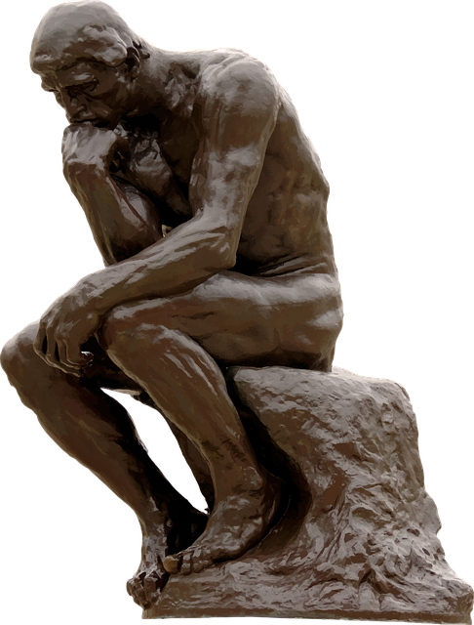
ALGORITHM AND SOLUTION STRATEGIES
Efficient
Maintainable

Slide 13
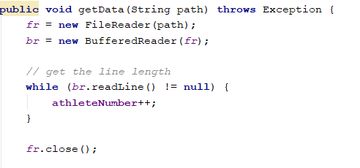
AlgorIthm And Solutıon Strategıes
File Operations:
The first step of the program is reading the input from a text file.
Code in the right, counts the number of the lines, in order to create an array of athletes.

Slide 14
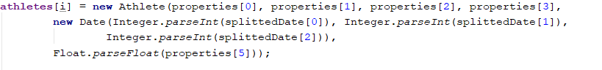
AlgorIthm And Solutıon Strategıes
File Operations:
After creating the array, for every line, we create a new Athlete object with the information in the array, which is split by commas.
Athlete(String country, String branch, String fullName, String gender, Date birthday, float skill)

Slide 15
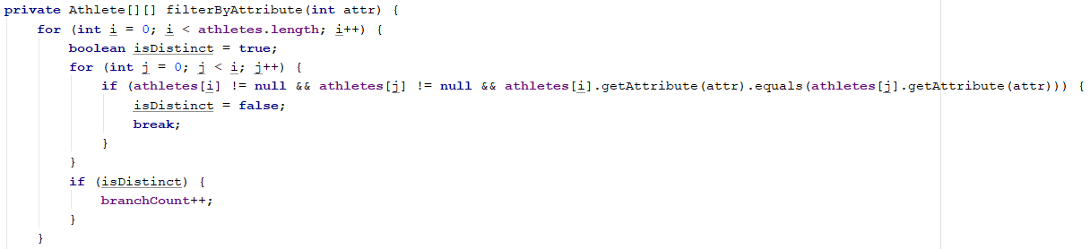
AlgorIthm And Solutıon Strategıes
Grouping Algorithm:
In order to match the athletes with same branch, grouping the athletes was necessary.
To accomplish this, the array of athletes was transformed to a two dimensional array.

Slide 16

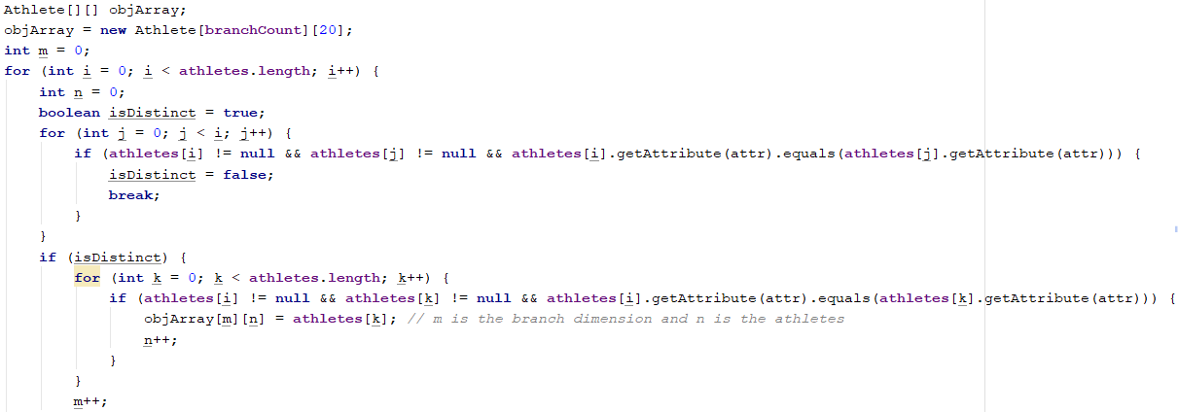
AlgorIthm And Solutıon Strategıes
Grouping Algorithm:

Slide 17
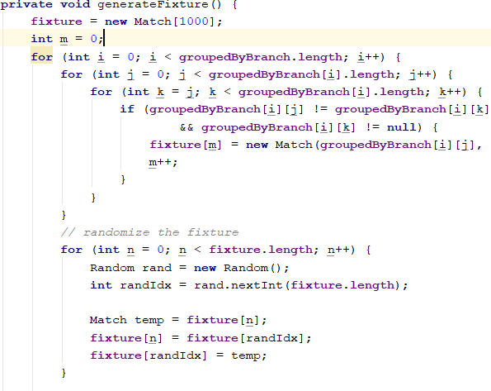
AlgorIthm And Solutıon Strategıes
Fixture Generation:
Here, the fixture is generated, and every athlete with same branch are matched.
After creating the fixture, all elements in the fixture are randomly replaced.

Slide 18

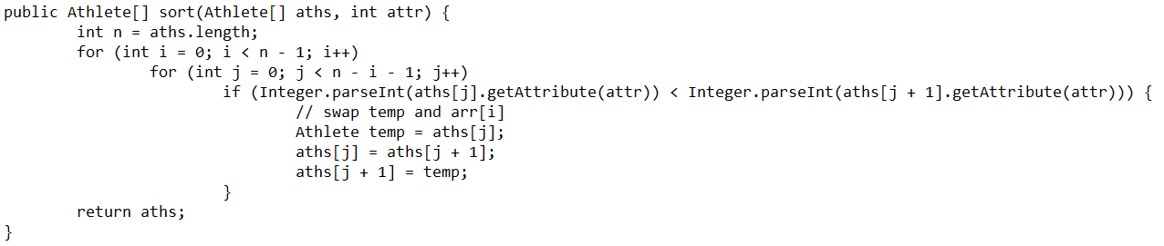
AlgorIthm And Solutıon Strategıes
Sorting Algorithm:

Slide 19
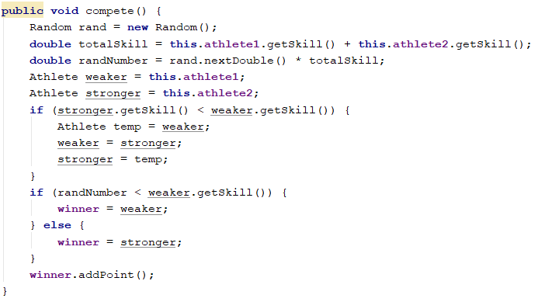
AlgorIthm And Solutıon Strategıes
Competing Algorithm:
A skill based luck algorithm is implemented.
Winner is an attributte of the match class.
Winner gets a point.
Notes:
Weaker is asigned as athlete one.
Stronger is asigned as athlete two.
However, computer can’t see
which one is weaker or stronger.
So we gotta point it.

Slide 20

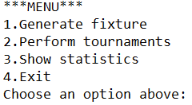
SCREENSHOTS
Main menu
Notes:
This is our menu.
You can do these things.
Generating fixture,
Performing tournaments ,
Showing statistics orr
You can exit simply ☺

Slide 21

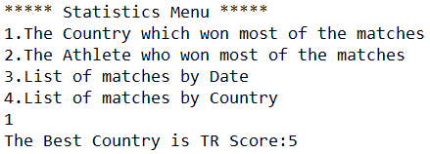
SCREENSHOTS
Inside menu
Notes:
Statistic option one shows the best country. In here, Turkey the best ☺ ☺

Slide 22

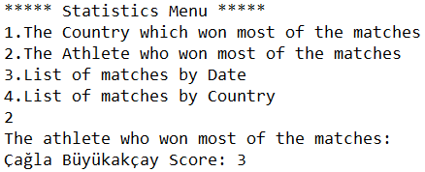
SCREENSHOTS
Inside menu
Notes:
Statistic option two shows the best athlete. In here, Turkish athlete is the best. What a concidence :D

Slide 23

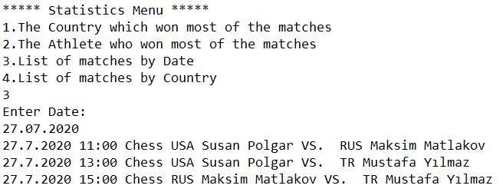
SCREENSHOTS
Inside menu
Notes:
Statistic option three lists of matches by date.

Slide 24

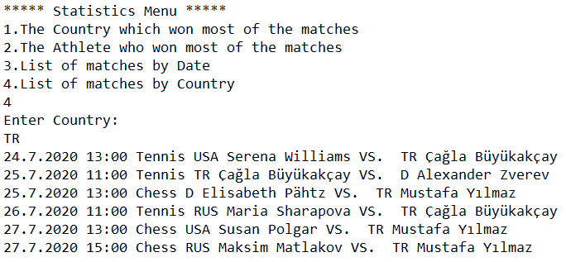

SCREENSHOTS
Inside menu
Notes:
Statistic option four lists of matches by country. You may wanna see all Turkish matches…

Slide 25



CONCLUSION
We have learned:
Creating class structure
Usage of “OOP Concept”
Team work (working with more people)
The project has been successfully accomplished on time exacly
Notes:
So, WHAT WE HAVE LEARNED?? …
We have learned: Creating class structure. This is the usage of “OOP Concept”.
Remark that most of companies looking for person who has got this skill…
I can honorly say that The project has been successfully accomplished on time exacly

Slide 26

REFERENCES
https://stackoverflow.com/questions/11644858/bubblesort-implementation [Bubble sort]
https://www.canva.com [Poster]
Poster…
Notes:
Here, our references.
We make some reaserch from Stackoverflow to learn bubble sort.
Besides, canva to make a poster.

Slide 27

Poster
Notes:
This is our poster

Slide 28

Any questıons?

